Slide 1
雲端計算
Cloud Computing
PaaS Techniques
Database

Slide 2
Agenda
Overview
  Hadoop & Google
PaaS Techniques
  File System
    GFS, HDFS
  Programming Model
    MapReduce, Pregel
  Storage System for Structured Data
    Bigtable, Hbase

Slide 3
Storage System for Structured Data
Database Overview
Relational Database (SQL)
Non-relational Database Introduction (NOSQL/NOREL)
Google Bigtable
Hadoop (Hbase)

Slide 4
Unstructured Data
Data can be of any type
  Not necessarily following any format or sequence
  Not follow any rules, so is not predictable
Two Categories
  Bitmap Objects
    Inherently non-language based, such as image, video or audio files
  Textual Objects
    Based on a written or printed language, such as Microsoft Word documents, e-mails or Microsoft Excel spreadsheets

Slide 5
Structure Data
Data is organized in semantic chunks (entities)
Similar entities are grouped together (relations or classes)
Entities in the same group have the same descriptions (attributes)
Descriptions for all entities in a group (schema)
  The same defined format
  A predefined length
  All present
  The same order

Slide 6
Semi-Structured Data
Organized in semantic entities
Similar entities are grouped together
Entities in same group may not have same attributes
  Order of attributes not necessarily important
  Not all attributes may be required
  Size of same attributes in a group may different
  Type of same attributes in a group may different

Slide 7
Example of Semi-Structured Data
Name: Computing Cloud
Phone_home: 035715131
Name: TA Cloud
Phone_cell: 0938383838
Email: cloudTA@gmail.com
Name: Student Cloud
Email: hiCloud@hotmail.com

Slide 8
Database, and Database Management System
Database
  A system intended to organize, store, and retrieve large amounts of data easily
Database management system (DBMS)
  Consists of software that operates databases
  Provides storage, access, security, backup and other facilities

Slide 9
Storage System for Structured Data
Database Overview
Relational Database (SQL)
Non-relational Database Introduction (NOSQL/NOREL)
Google Bigtable
Hadoop (Hbase)

Slide 10
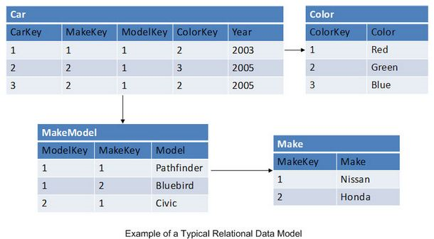
Relational Database(1/4)
Essentially a group of tables (entities)
  Tables are made up of columns and rows (tuples)
  Tables have constraints, and relationships defined between them
Facilitated through Relational Database Management Systems (RDBMS)

Slide 11
Relational Database(2/4)
Multiple tables being accessed in a single query are "joined" together
Normalization is a data-structuring model used with relational databases
  Ensures data consistency
  Removes data duplication
Almost all database systems we use today are RDBMS
  Oracle
  SQL Server
  MySQL
  DB2
  …

Slide 12
Relational Database(3/4)
Advantages
  Simplicity
  Robustness
  Flexibility
  Performance
  Scalability
  Compatibility in managing generic data
However,
  To offer all of these, relational databases have to be incredibly complex internally

Slide 13
Relational Database(4/4)
It’s a problem in a different situation but not disadvantage
  A large-scale Internet application services
    Their scalability requirements can, first of all, change very quickly and, secondly, grow very large.
    Relational databases scale well, but usually only when that scaling happens on a single server node.
    This is when the complexity of relational databases starts to rub against their potential to scale.
  Cloud services to be viable
    A cloud platform without a scalable data store is not much of a platform at all

Slide 14
Storage System for Structured Data
Database Overview
Relational Database (SQL)
Non-relational Database Introduction (NOSQL/NoREL)
Google Bigtable
Hadoop (Hbase)

Slide 15
Non-relational Database Introduction
NOSQL Overview
Related Theorem
Distributed Database System

Slide 16
What is NOSQL
Not Only SQL
  A term used to designate database management systems
  Differ from classic relational database management systems
  The most common interpretation of "NoSQL" is “Non-relational“ (NoREL, not widely used)
Some NOSQL examples
  Google Bigtable
    Open Source - Apache Hbase
  Amazon Dynamo
  Apache Cassandra
Emphasizes the advantages of Key/Value Stores, Document Databases, and Graph Databases

Slide 17
Key/Value Database(1/4)
No official name yet exists, so you may see it referred to
  Document-oriented
  Internet-facing
  Attribute-oriented
  Distributed database (this can be relational also)
  Sharded sorted arrays
  Distributed hash table
  Key/value database(datastore)

Slide 18
Key/Value Database(2/4)
No Entity Joins
  Key/value databases are item-oriented
  All relevant data relating to an item are stored within that item
  A domain (a table) can contain vastly different items
  This model allows a single item to contain all relevant data
    Improves scalability by eliminating the need to join data from multiple tables
    With a relational database, such data needs to be joined to be able to regroup relevant attributes.

Slide 19
Key/Value Database(3/4)
Advantages of key/value DBs to relational DBs
  Suitability for Clouds
    Key/Value DBs are simple and thus scale much better than relational databases
    Provides a relatively cheap data store platform with massive potential to scale
  More Natural Fit with Code
    Relational data models and Application Code Object Models are typically built differently
    Key/value databases retain data in a structure that maps more directly to object classes used in the underlying application code

Slide 20
Key/Value Database(4/4)
Disadvantages of key/value DBs to relational DBs
  Data integrity issues
    Data that violate integrity constraints cannot physically be entered into the relational DB
    In a key/value DB, the responsibility for ensuring data integrity falls entirely to the application
  Application-dependent
    Relational DBs modeling process creates a logical structure that reflects the data it is to contain, rather than reflecting the structure of the application
    Key/value DBs can try replacing the relational data modeling exercise with a class modeling exercise
  Incompatibility

Slide 21
Non-relational Database Introduction
NOSQL Overview
Related Theorem
Distributed Database System

Slide 22
CAP Theorem(1/2)
When designing distributed data storage systems, it’s very common to invoke the CAP Theorem
  Consistency, Availability, Partition-tolerance
Consistency
  The goal is to allow multisite transactions to have the familiar all-or-nothing semantics.
Availability
  When a failure occurs, the system should keep going, switching over to a replica, if required.
Partition-tolerance
  If there is a network failure that splits the processing nodes into two groups that cannot talk to each other, then the goal would be to allow processing to continue in both subgroups.

Slide 23
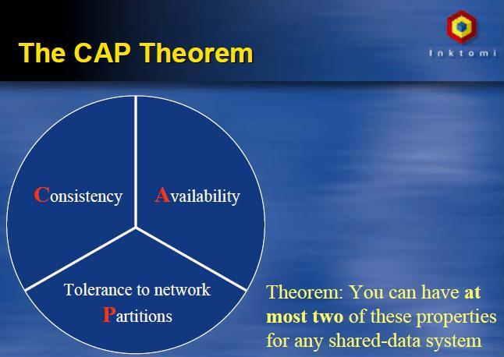
CAP Theorem(2/2)
Consistency, availability, partition tolerance. Pick two.
  If you have a partition in your network, you lose either consistency (because you allow updates to both sides of the partition) or you lose availability (because you detect the error and shutdown the system until the error condition is resolved).

Slide 24
Non-relational Database Introduction
NOSQL Overview
Related Theorem
Distributed Database System

Slide 25
Introduction
Distributed database system = distributed database + distributed DBMS
  Distributed database
    a collection of multiple inter-correlated databases distributed over a computer network
  Distributed DBMS
    manage a distributed database and make the distribution transparent to users
Consists of
  query nodes: user interface routines
  data nodes: data storage
Loosely coupled: connected with network, each node has its own storage / processor / operating system

Slide 26
System Architectures
Centralized
  one host for everything, multi-processor is possible but a transaction gets only one processor
Parallel
  a transaction may be processed by multiple processors
Client-Server
  database stored on one server host for multiple clients, centrally managed
Distributed
  database stored on multiple hosts, transparent to clients
Peer to Peer
  each node is a client and a server; requires sophisticated protocols, still in development

Slide 27
Data Models
Hierarchical Model
  Data organized in a tree namespace
Network Model
  Like Hierarchical Model, but a data may have multiple parents
Entity-Relationship Model
  Data are organized in entities which can have relationships among them
Object-Oriented Model
  Database capability in an object-oriented language
Semi-structured Model
  Schema is contained in data (often associated with “self-describing” and “XML”)

Slide 28
Data distribution
Data is physically distributed among data nodes
  Fragmentation: divide data onto data nodes
  Replication: copy data among data nodes
Fragmentation enables placing data close to clients
  May reduce size of data involved
  May reduce transmission cost
Replication
  Preferable when the same data are accessed from applications that run at multiple nodes
  May be more cost-effective to duplicate data at multiple nodes rather than continuously moving it between them
Many different schemes of fragmentation and replication

Slide 29
Fragmentation
Horizontal fragmentation
  split by rows based on a fragmentation predicate
Vertical fragmentation
  split by columns based on attributes
Also called “partition” in some literature
Last name | First name | Department | ID
Chang | Three | Computer Science | X12045
Lee | Four | Law | Y34098
Chang | Frank | Medicine | Z99441
Wang | Andy | Medicine | S94717

Slide 30
Properties
Concurrency control
  Make sure the distributed database is in a consistent state after a transaction
Reliability protocols
  Make sure termination of transactions in the face of failures (system failure, storage failure, lost message, network partition, etc)
One copy equivalence
  The same data item in all replicas must be the same

Slide 31
Query Optimization
Looking for the best execution strategy for a given query
Typically done in 4 steps
  query decomposition: translate query to relational algebra (for relational database) and analyze/simplify it
  data localization: decide which fragments are involved and generate local queries to fragments
  global optimization: finding the best execution strategy of queries and messages to fragments
  local optimization: optimize the query at a node for a fragment
Sophisticated topic

Slide 32
Storage System for Structured Data
Database Overview
Relational Database (SQL)
Non-relational Database Introduction (NOSQL/NoREL)
Google Bigtable
Hadoop (Hbase)

Slide 33
Bigtable
How to manage structured data in a distributed storage system that is designed to scale to a very large size …

Slide 34
Overview
Bigtable Introduction
Implementation
Details
Conclusions

Slide 35
Bigtable Introduction
Motivation
Building Model
Data Model

Slide 36
Motivation
Lots of (semi-)structured data at Google
  Web
    contents, crawl metadata, links/anchors/pagerank, …
  Per-user data
    user preference settings, recent queries, search results, …
  Geographic locations
    physical entities (shops, restaurants, etc.), roads, satellite image data, user annotations, …
Scale is large
  Billions of URLs, many versions/page (~20K/version)
  Hundreds of millions of users, thousands of queries/sec
  100TB+ of satellite image data

Slide 37
Bigtable Introduction
Motivation
Building Model
Data Model

Slide 38
Typical Cluster
Cluster scheduling master
Lock service
GFS master
Machine 1
Machine 2
Machine N
User
app1
BigTable
server
BigTable
server
User
app1
BigTable master
User app2
…
Scheduler
slave
GFS
chunkserver
Scheduler
slave
GFS
chunkserver
Scheduler
slave
GFS
chunkserver
Linux
Linux
Linux

Slide 39
System Structure
Typical Bigtable Cell
Bigtable client
Bigtable Master
metadata ops
Client library
Performs metadata ops, load-balancing
Read, write
Read, write
Read, write
Bigtable tablet server
Bigtable tablet server
Bigtable tablet server
…
Serves data
Serves data
Serves data
Open ()
Cluster scheduling system
Google File system (GFS)
Lock service(Chubby)
Handles failover, monitoring
Holds tablet data, logs
Holds metadata, handles master election

Slide 40
Building Blocks
Google WorkQueue (scheduler)
Distributed File System (GFS): large-scale distributed file system
  Master: responsible for metadata
  Chunk servers: responsible for r/w large chunks of data
  Chunks replicated on 3 machines; master responsible
Lock service (Chubby): lock/file/name service
  Coarse-grained locks; can store small amount of data in a lock
  5 replicas; need a majority vote to be active (Paxos)

Slide 41
Key Jobs in a BigTable Cluster
Master
  Schedules tablets assignments
  Quota management
  Health check of tablet servers
  Garbage collection management
Tablet servers
  Serve data for reads and writes (one tablet is assigned to exactly one tablet server)
  Compaction
  Replication

Slide 42
Bigtable Introduction
Motivation
Building Model
Data Model

Slide 43
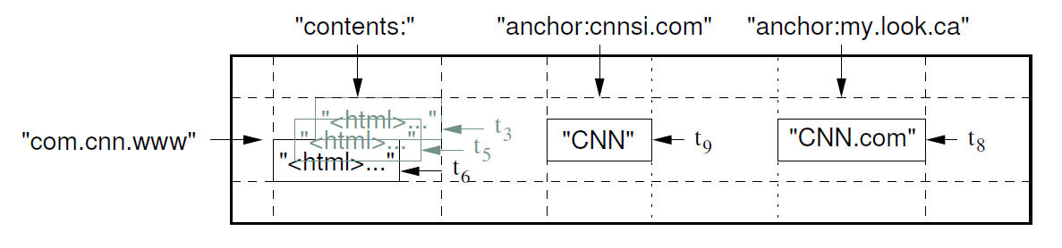
Data Model
Semi-structured: multi-dimensional sparse map
  (row, column, timestamp) → cell contents
Good match for most of Google's applications
Columns
Row
Timestamps

Slide 44
Rows
Everything is a string
Every row has a single key
  An arbitrary string
  Access to data in a row is atomic
  Row creation is implicit upon storing data
Rows ordered lexicographically by key
  Rows close together lexicographically usually on one or a small number of machines
No such things as empty row

Slide 45
Columns
Arbitrary number of columns
  Organized into column families, then locality groups
  Data in the same locality group are stored together
Don't predefine columns (compare: schema)
  “Multi-map,” not “table.” Column names are arbitrary strings
  Sparse: a row contains only the columns that have data

Slide 46
Column Family
Must be created before any column in the family can be written
  Has a type: string, protocol buffer
  Basic unit of access control and usage accounting
    different applications need access to different column families.
    careful with sensitive data
A column key is named as family:qualifier
  Family: printable; qualifier: any string.
  Usually not a lot of column families in a BigTable cluster (hundreds)
    one “anchor:” column family for all anchors of incoming links
  But unlimited columns for each column family
    columns: “anchor:cnn.com”, “anchor:news.yahoo.com”, “anchor:someone.blogger.com”, …

Slide 47
Timestamps
Used to store different versions of data in a cell
  New writes default to current time, but timestamps for writes can also be set explicitly by clients
Lookup options
  “Return most recent K values”
  “Return all values in timestamp range (or all values)”
Column families can be marked w/ attributes
  “Only retain most recent K values in a cell”
  “Keep values until they are older than K seconds”

Slide 48
ImplementatioN
Tablet
Tablet Location
Compaction

Slide 49
SSTable
SSTable: sorted string table
  Persistent, ordered, immutable map from keys to values
    keys and values are arbitrary byte strings
  Contains a sequence of blocks (typical size = 64KB), with a block index at the end of SSTable loaded at open time
  One disk seek per block read
  Operations: lookup(key),
  iterate(key_range)
  An SSTable can be
  mapped into memory
SSTable
64K block
64K block
64K block
Index

Slide 50
Tablets & Splitting
“language:”
“contents:”
“aaa.com”
“cnn.com”
EN
“<html>…”
“cnn.com/sports.html”
Tablets
…
“website.com”
…
“yahoo.com/kids.html”
…
“yahoo.com/kids.html\0”
…
“zuppa.com/menu.html”

Slide 51
Tablets (1/2)
Large tables broken into tablets at row boundaries
  Tablet holds contiguous range of rows
    Clients can often choose row keys to achieve locality
  Aim for ~100MB to 200MB of data per tablet
Serving machine responsible for ~100 tablets
  Fast recovery:
    100 machines each pick up 1 tablet from failed machine
  Fine-grained load balancing:
    Migrate tablets away from overloaded machine
    Master makes load-balancing decisions

Slide 52
Tablets (2/2)
Dynamic fragmentation of rows
  Unit of load balancing
  Distributed over tablet servers
  Tablets split and merge
    automatically based on size and load
    or manually
  Clients can choose row keys to achieve locality
Tablet
Start:aardvark
End:apple
64K block
64K block
64K block
SSTable
64K block
64K block
64K block
SSTable
Index
Index

Slide 53
Tablet Assignment
Master keeps track of the set of live tablet servers, and the current assignment of tablets to tablet servers, including which tablets are unassigned
Tablet servers
Cluster manager
Chubby
1) Start a server
8) Reassign unassigned tablets
2) Create a lock
7) Acquire and
Delete the lock
3) Acquire the lock
4) Monitor
Tablet Server
5) Assign tablets
Master Server
6) Check lock status

Slide 54
Tablet Serving
Memory
read
memtable
(random-access)
append-only log on GFS
write
SSTable
on GFS
SSTable
on GFS
Tablet
SSTable: Immutable on-disk ordered map from string->string
string keys: <row, column, timestamp> triples

Slide 55
ImplementatioN
Tablet
Tablet Location
Compaction

Slide 56
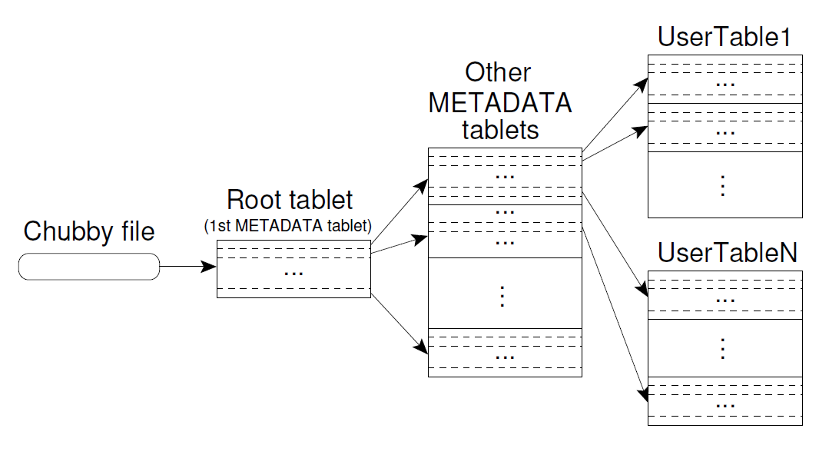
Locating Tablets (1/2)
MD0

Slide 57
Locating Tablets (2/2)
Approach: 3-level B+-tree like scheme for tablets
  1st level: Chubby, points to MD0 (root)
  2nd level: MD0 data points to appropriate METADATA tablet
  3rd level: METADATA tablets point to data tablets
METADATA tablets can be split when necessary
MD0 never splits so number of levels is fixed

Slide 58
ImplementatioN
Tablet
Tablet Location
Compaction

Slide 59
Compactions(1/2)
Tablet state represented as set of immutable compacted SSTable files (buffered in memory)
Minor compaction
  When in-memory state fills up, pick tablet with most data and write contents to SSTables stored in GFS
Major compaction
  Periodically compact all SSTables for tablet into new base SSTable on GFS
    Storage reclaimed from deletions at this point (garbage collection)

Slide 60
Compactions(2/2)
Full
V5.0
memtable
A new memtable
Frozen memtable
Read ops
Memory
GFS
Tablet log
V4.0
V3.0
V2.0
V1.0
Merging compaction
Major compaction
Write ops
Memtable + a few SSTables
-> A new SSTable
Memtable + all SSTables
-> to one SSTable
SSTable files
Periodically done.
Deleted data are still alive.
Minor compaction
Memtable -> a new SSTable
V6.0
Deleted data are removed
Storage can be re-used

Slide 61
Details
Locality groups
Compression
Replication

Slide 62
Locality Groups(1/2)
Locality Groups
“contents:”
“language:”
“pagerank:”
“www.cnn.com”
“<html>…”
EN
0.5
…
…

Slide 63
Locality Groups(2/2)
Dynamic fragmentation of column families
  Segregates data within a tablet
  Different locality groups → different SSTable files on GFS
  Scans over one locality group are O(bytes_in_locality_group) , not O(bytes_in_table)
Provides control over storage layout
  Memory mapping of locality groups
  Choice of compression algorithms
  Client-controlled block size

Slide 64
Details
Locality groups
Compression
Replication

Slide 65
Compression(1/2)
Keys:
  Sorted strings of (Row, Column, Timestamp): prefix compression
Values:
  Group together values by “type” (e.g. column family name)
  BMDiff across all values in one family
    BMDiff output for values 1..N is dictionary for value N+1
Zippy as final pass over whole block
  Catches more localized repetitions
  Also catches cross-column-family repetition, compresses keys

Slide 66
Compression(2/2)
Many opportunities for compression
  Similar values in the same row/column at different timestamps
  Similar values in different columns
  Similar values across adjacent rows
Within each SSTable for a locality group, encode compressed blocks
  Keep blocks small for random access (~64KB compressed data)
  Exploit fact that many values very similar
  Needs to be low CPU cost for encoding/decoding
Two building blocks: BMDiff, Zippy

Slide 67
Details
Locality groups
Compression
Replication

Slide 68
Replication
Often want updates replicated to many BigTable cells in different datacenters
  Low-latency access from anywhere in world
  Disaster tolerance
Optimistic replication scheme
  Writes in any of the on-line replicas eventually propagated to other replica clusters
    99.9% of writes replicated immediately (speed of light)
  Currently a thin layer above BigTable client library
    Working to move support inside BigTable system

Slide 69
Summary of Bigtable
Data model applicable to broad range of clients
  Actively deployed in many of Google’s services
System provides high performance storage system on a large scale
  Self-managing
  Thousands of servers
  Millions of ops/second
  Multiple GB/s reading/writing

Slide 70
Storage System for Structured Data
Database Overview
Relational Database (SQL)
Non-relational Database Introduction (NOSQL/NoREL)
Google Bigtable
Hadoop Hbase

Slide 71
Hbase
Overview
Architecture
Data Model
Different from Bigtable

Slide 72
What’s Hbase
Distributed Database modeled on column-oriented rows
Tables of column- oriented rows
Scalable data store(scales horizontally)
Apache Hadoop subproject since 2008
Cloud Applications
MapReduce
Hbase
Hadoop Distributed
File System (HDFS)
A Cluster of Machines

Slide 73
Hbase
Overview
Architecture
Data Model
Different from Bigtable

Slide 74
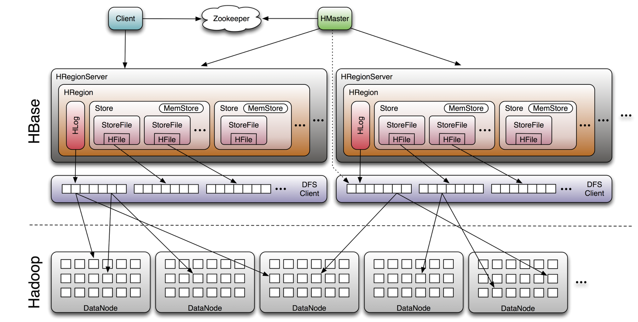
Hbase Architecture

Slide 75
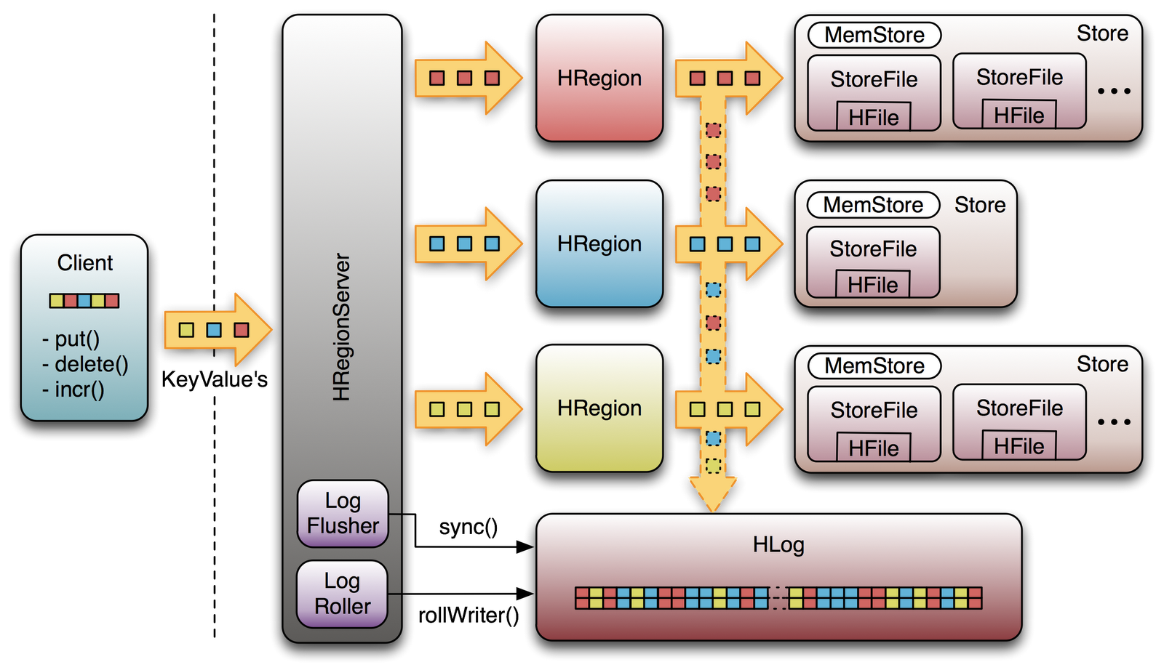
How does Hbase work?

Slide 76
Roles mapping
Bigtable : Hbase
  Master : (H)Master
  Tabletserver : (H)Regionserver
    Tablet : Region
  Google File System : Hadoop Distributed File System
    SSTable : HFile
  Chubby : Zookeeper

Slide 77
Roles in Hbase(1/2)
Master
  Cluster initialization
  Assigning/unassigning regions to/from Regionservers (unassigning is for load balance)
  Monitor the health and load of each Regionserver
  Changes to the table schema and handling table administrative functions
  Data localization
Regionservers
  Serving Regions assigned to Regionserver
  Handling client read and write requests
  Flushing cache to HDFS
  Keeping Hlog
  Compactions
  Region Splits

Slide 78
Roles in Hbase(2/2)
Zookeeper
  Master election and recovery
  Store membership info
  Locate -ROOT- region
HDFS
  All persistence Hbase storage is on HDFS(HFile, c.f. google Bigtable, SSTable)
  HDFS reliability and performance are key to Hbase reliability and performance

Slide 79
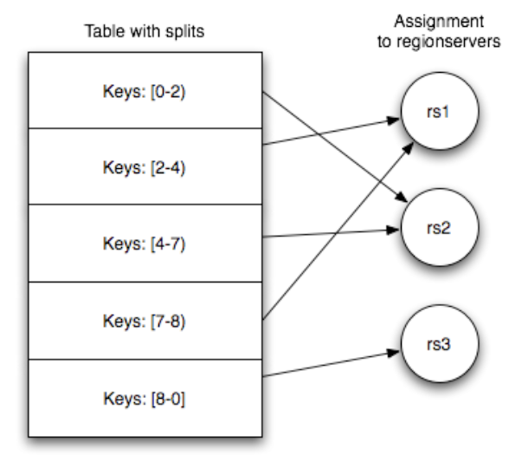
Table & Region
Rows stored in byte‐lexicographic sorted order
Table dynamically split into “regions”
Each region contains values [startKey, endKey)
Regions hosted on a regionserver

Slide 80
Hbase
Overview
Architecture
Data Model
Different from Bigtable

Slide 81
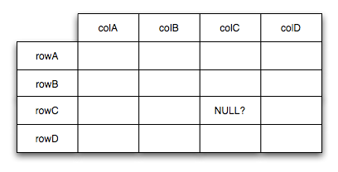
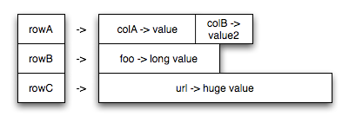
Data Model

Slide 82
Data Model (cont.)
Data are stored in tables of rows and columns
  Columns are grouped into column families
    A column name has the form “<family>:<label>”
    Table consists of 1+ “column families”
    Column family is unit of performance tuning
  Rows are sorted by row key, the table's primary key
Cells are ”versioned”
  Each row id + column – stored with timestamp
    Hbase stores multiple versions
    (table, row, <family>:<label>, timestamp) ⟶ value
  Can be useful to recover data due to bugs
  Use to detect write conflicts/collisions

Slide 83
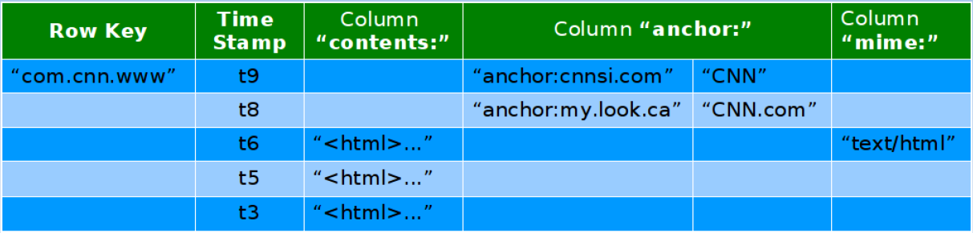
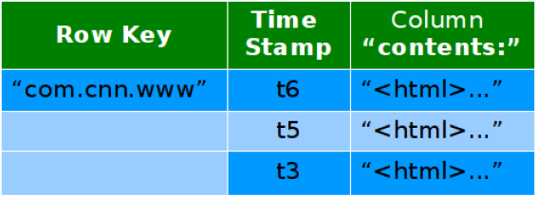
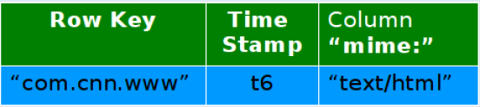
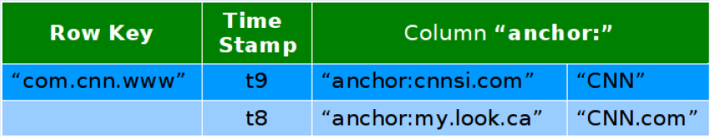
Example
Conceptual View
Physical Storage View

Slide 84
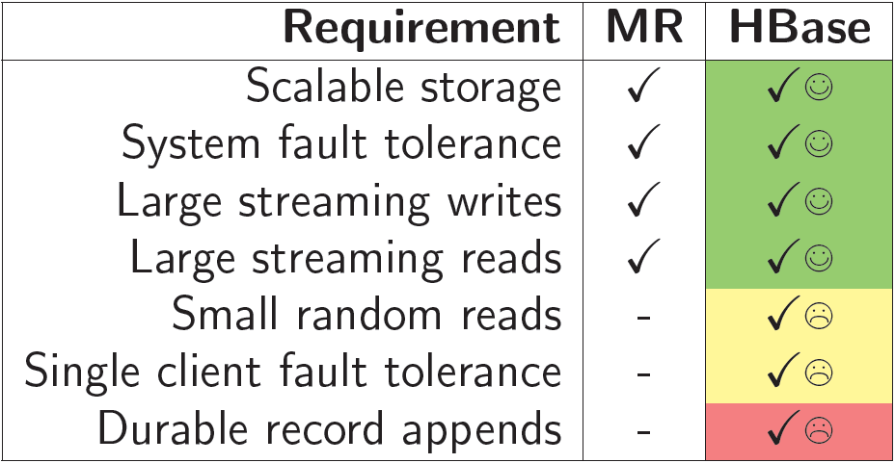
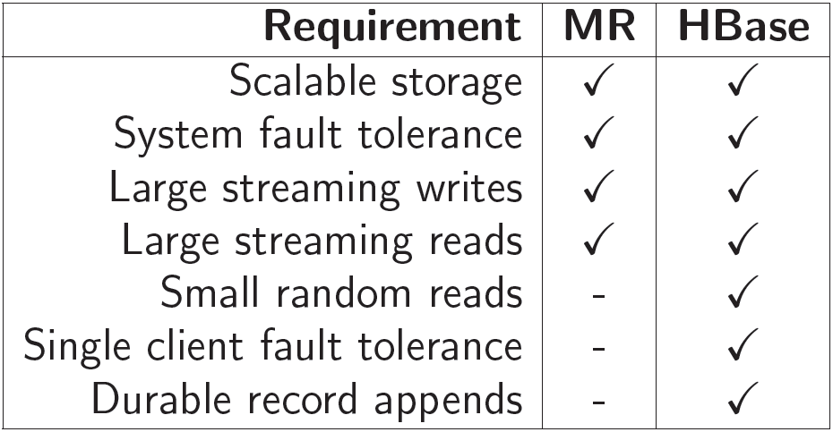
Hbase w/ Hadoop
Easy integration with Hadoop MapReduce(MR)
  Table input and output formats ship
Look from HDFS (HDFS Requirements Matrix)

Slide 85
Hbase
Overview
Architecture
Data Model
Different from Bigtable

Slide 86
Different from Bigtable
Number of Master
  Hbase added support for multiple masters. These are on "hot" standby and monitor the master's ZooKeeper node
Storage System
  Hbase has the option to use any file system as long as there is a proxy or driver class for it
    HDFS, S3(Simple Storage Service), S3N(S3 Native FileSystem)
Memory Mapping
  BigTable can memory map storage files directly into memory

Slide 87
Different from Bigtable (cont.)
Lock Service
  ZooKeeper is used to coordinate tasks in Hbase as opposed to provide locking services
  ZooKeeper does for Hbase pretty much what Chubby does for BigTable with slightly different semantics
Locality Groups
  Hbase does not have this option and handles each column family separately

Slide 88
Summary
Scalability
  Provide scale-out storage capability of handling very large amounts of data.
Availability
  Provide the scheme of data replication based on a reliable google file system to support high availability for data store.
Manageability
  Provide mechanism for the system to automatically monitor itself and manage the massive data transparently for users.
Performance
  High sustained bandwidth is more important than low latency.

Slide 89
References
Chang, F., et al. “Bigtable: A distributed storage system for structured data.” In OSDI (2006).
Hbase.
  http://hbase.apache.org/
NCHC Cloud Computing Research Group.
  http://trac.nchc.org.tw/cloud
NTU course- Cloud Computing and Mobile Platforms.
  http://ntucsiecloud98.appspot.com/course_information
Wiki.
  http://en.wikipedia.org/wiki/Database#Database_management_systems

